Slide 1

Production of a Tube and Box Lab Furnace for 1600 C
ÇINAR ÖNCEL
AHMET BEKİR SOLAK 160713008
BERKAY HOPAL 150713018
YUNUS EMRE ALTAŞ 360713056
SILA İNAN 160713006
MERVE DÖKER 150713023
MERTCAN MUHAMMET AYDIN 150713026
OĞULCAN HAKSEVER 160702035
EVREN KAĞAN GÜRSEL 170702001

Slide 2
Motivation of Project
The general purpose of the project is to produce a furnace that can be used at any temperature up to 1600 C, which can be both a tube furnace and a box furnace at the same time. In this way, in addition to all the experiments that can be done in the box furnace, it is our goal to commercially produce and promote a new furnace where all the experiments can be done with atmosphere control in the tube furnace can be done. In this way, an economical and space-saving product will be developed for users. When this goal is achieved, a new product that is unique in the market and that we have a patent will be produced.

Slide 3
Main Parts of the Furnace
Casing
Refractory Materials and Heating elements
Control Panel – Electrical Equipments

Slide 4
Casing
Casing material is steel
Casing material thickness is 1mm
Dimensions of the furnace;
Height: 800mm
Width: 750mm
Depth: 675mm
Lid thickness: 75mm

Slide 5
Casing Components
Case of the Furnace
Inner Part
Lid of the Furnace
Alumina Tube
Rail Systems
Control Panel

Slide 6
Inner Part
The total inner volume of the furnace : 18liters.
4 kinds of materials are used in the interior of the furnace for insulation purposes. These are ceramic board, mullite insulation brick, ceramic fiber blanket and aluminum foil respectively.
The total refractory thickness is 17.5 cm.
Used heating element numbers are 6.

Slide 7
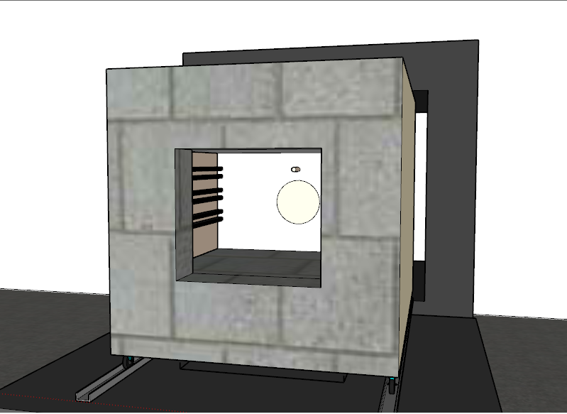

Slide 8
Lid of the Furnace
Insulation of the lid provided with ceramic board with 10cm total thickness.
2 layers of ceramic board are used.
-Upper layer thickness is 3cm
Bottom layer thickness is 7cm

Slide 9
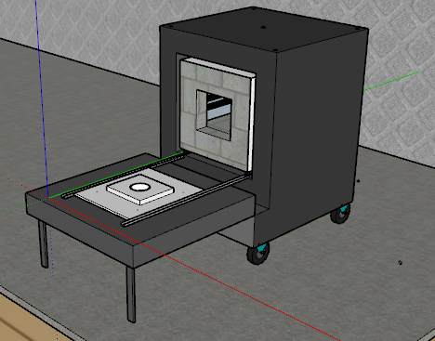
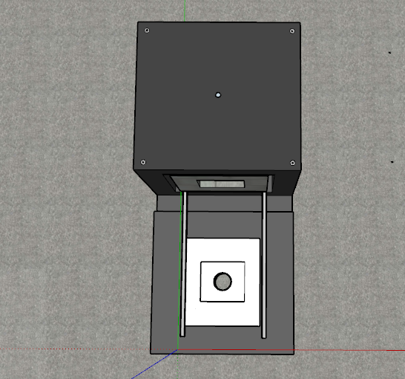

Slide 10
Alumina Tube
High purity alumina tube is selected according to the operation temperature and thermal stability. 98%Al₂O₃ Purity.
Dimensions of the alumina tube
- Length is 1000mm
- Total Radius is 80mm
- Inner Radius is 70mm

Slide 11
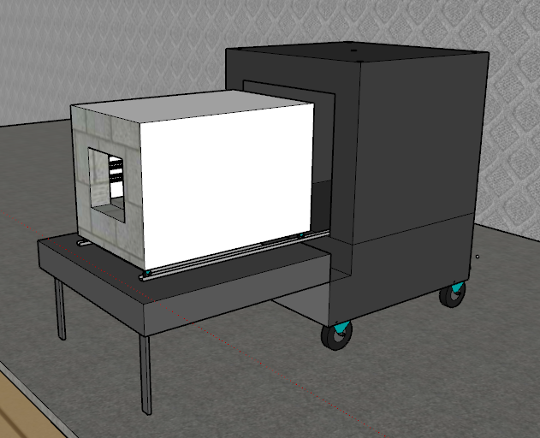
Rail Systems
There are rail systems for easy repair and replacement for the control panel and inner part.

Slide 12
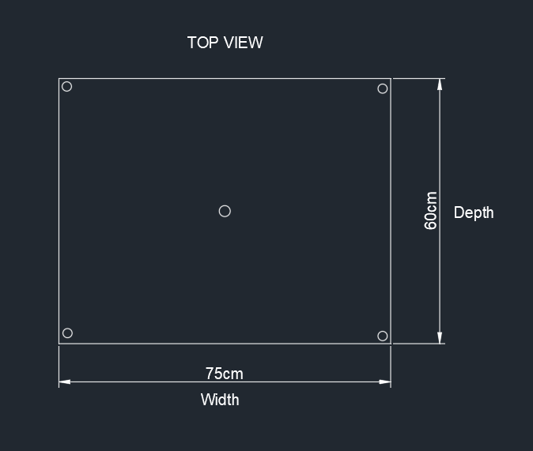
Technical Drawings of the Furnace

Slide 13
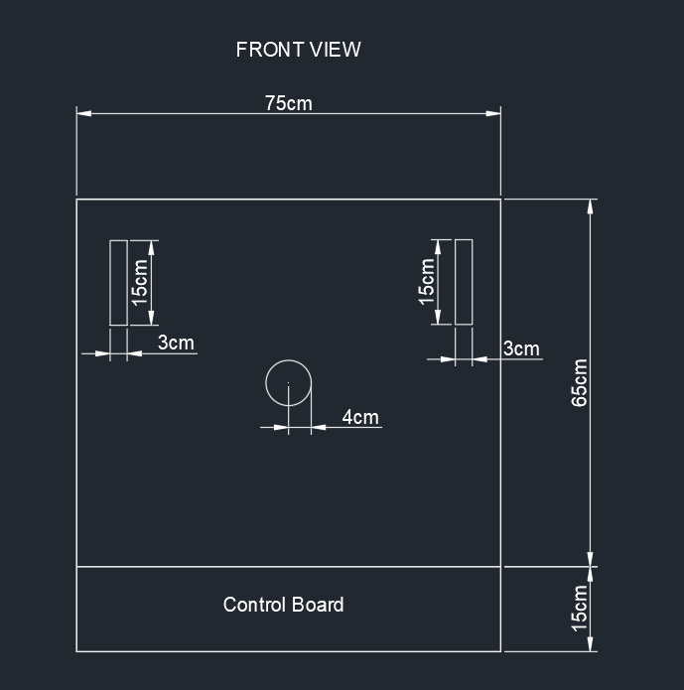

Slide 14
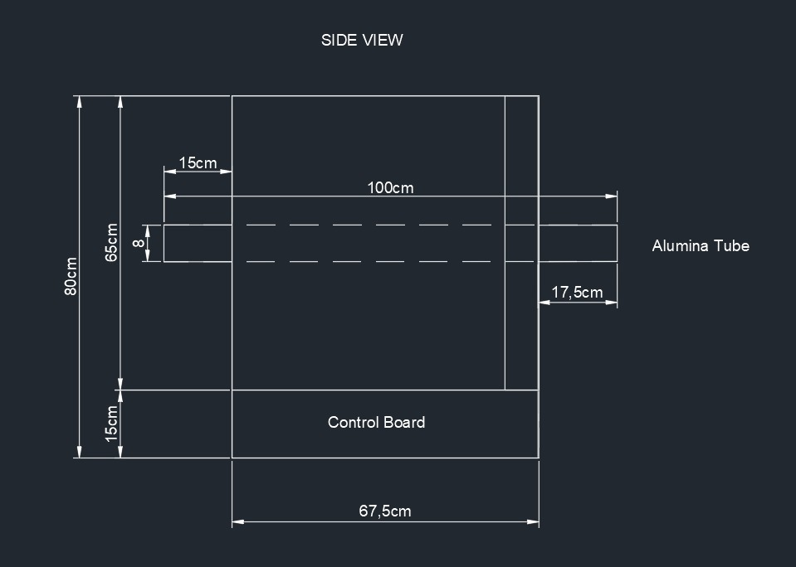

Slide 15
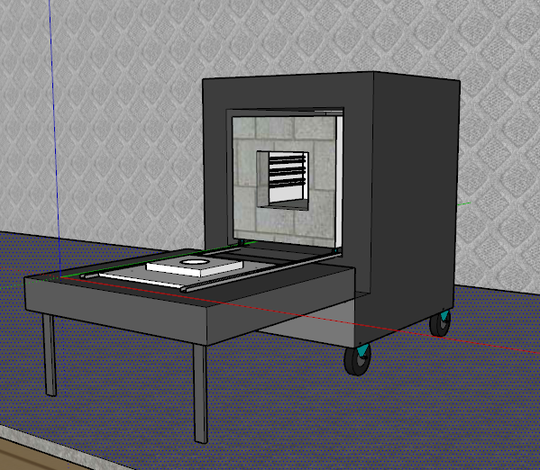
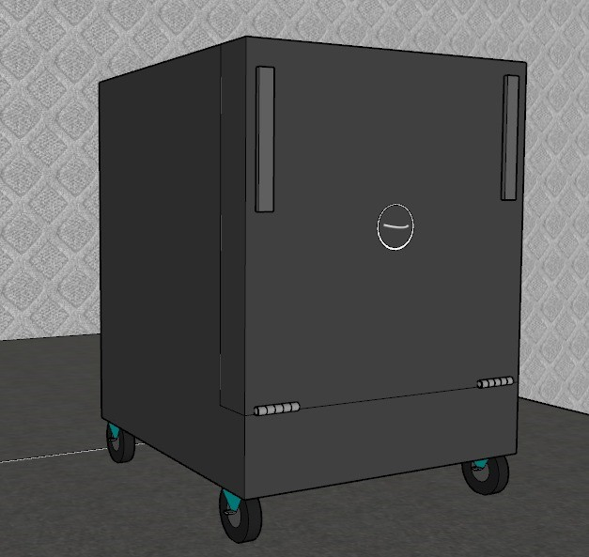
Used as Box Furnace

Slide 16
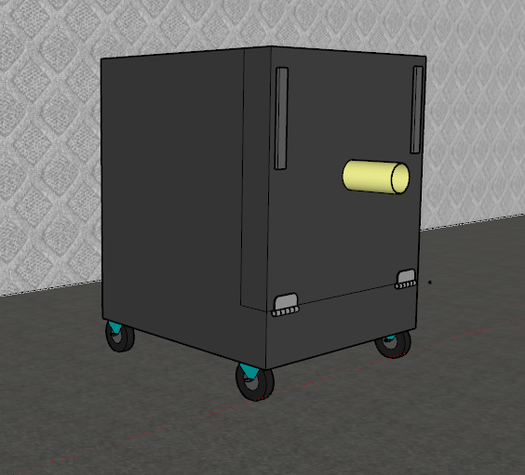
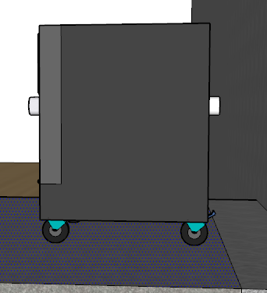
Used as Tube Furnace

Slide 17
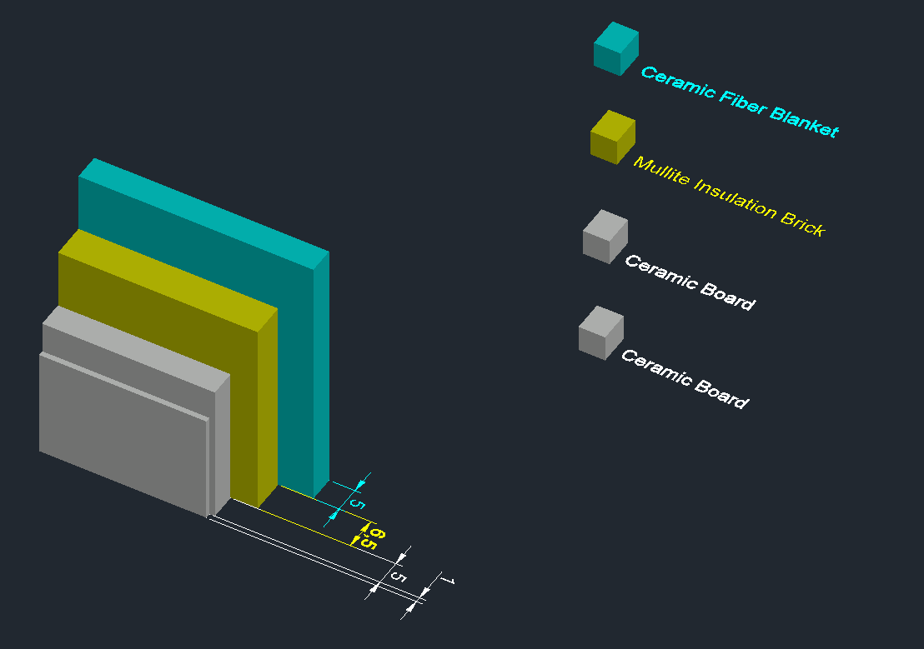
Refractories
One of the purposes of refractory use is to minimize the heat loss of the furnace.
Heat is transmitted by three ways: convection, conduction and radiation. With the refractory materials used , the heat loss caused by conduction and convection can be reduced , but another material is needed to prevent heat loss caused by radiation. Aluminum foil is ideal for this application as it is durable at 600 °C and has reflectivity higher than %90.

Slide 18
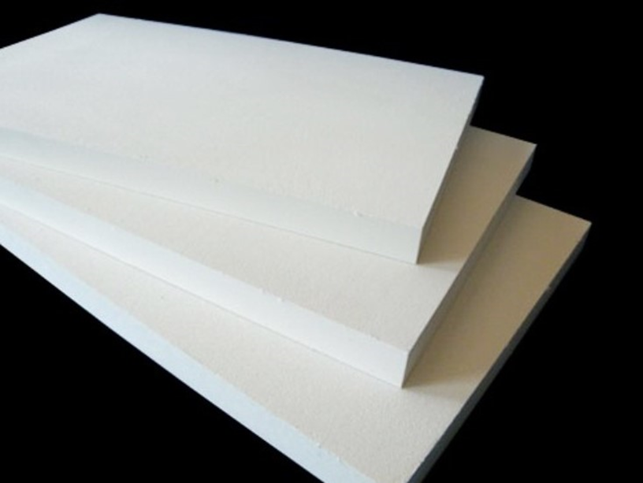
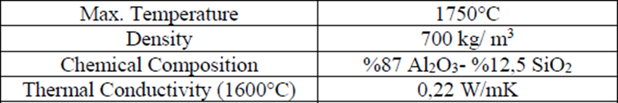
Ceramic Board
Low thermal conductivity
Low heat storage
Excellent thermal shock resistance
Resistant to most chemicals
Easy to cut and shape
Low sound transmission
Resists penetration by molten aluminum and other non-ferrous metals
https://www.northrefractories.com/product-detail/ceramic-fiber-board-high-temperature/

Slide 19
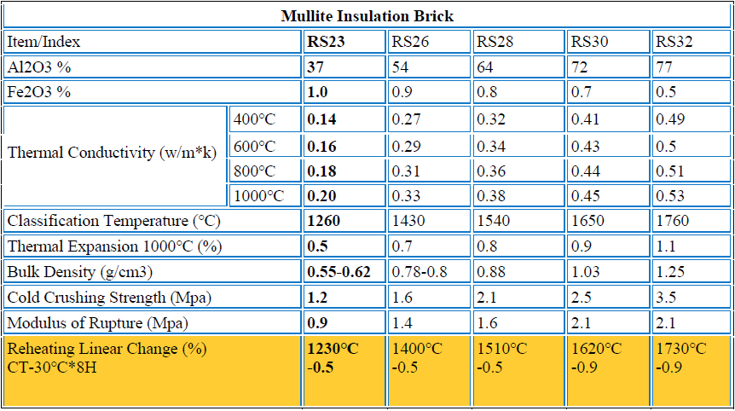
Mullite Insulation Brick
The refractoriness of the brick can reach temperatures up to 1790 ℃. It is stable at the temperatures up to 1600 ℃ after that point it may start to soften.
https://rsrefractoryfirebrick.com/mullite-insulation-brick/

Slide 20
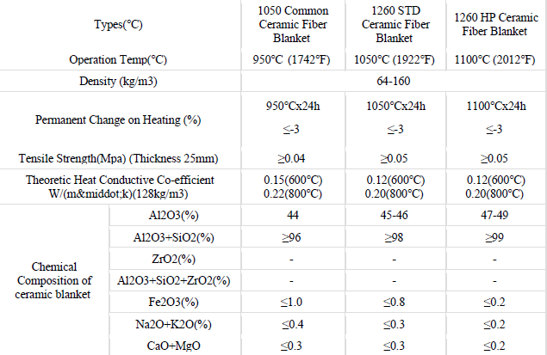
Ceramic Fiber Blanket
The thermal conductivity of Ceramic fiber blanket is close to air because it is composed of solid fiber and about 90% porosity. This high amount of porosity destroys the continuity of the solid structure thereby, provides excellent insulation properties.
https://www.ceceramicfiber.com/Products/Ceramicfiberblanket.html

Slide 21
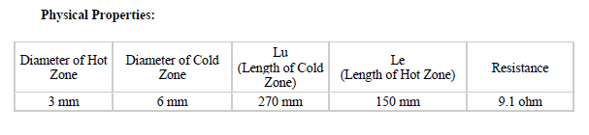
Heating Element
Molybdenum disilicide (MoSi₂) heating elements are resistant heating elements that prevent oxidation of the inner core by forming a compact quartz glass coating on the surface under high temperature. The temperature generated by MoSi₂ rises up to 1700-1830 °C in an oxidation atmosphere.
https://www.songshanheating.com/mosi2-u-type/

Slide 22
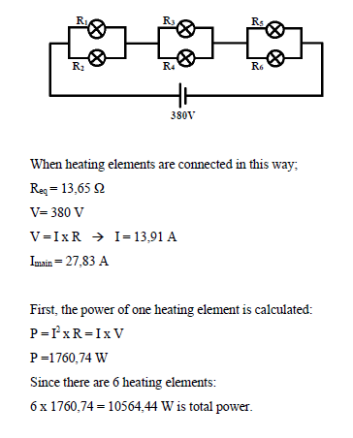

Slide 23
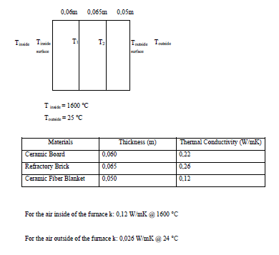
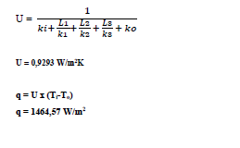
Heat Transfer Calculations

Slide 24
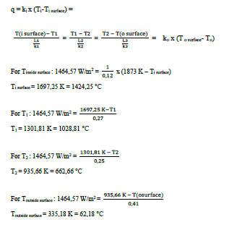
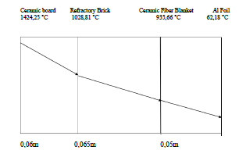

Slide 25
Electrical Components
Thermocouple
Control System
Relay

Slide 26
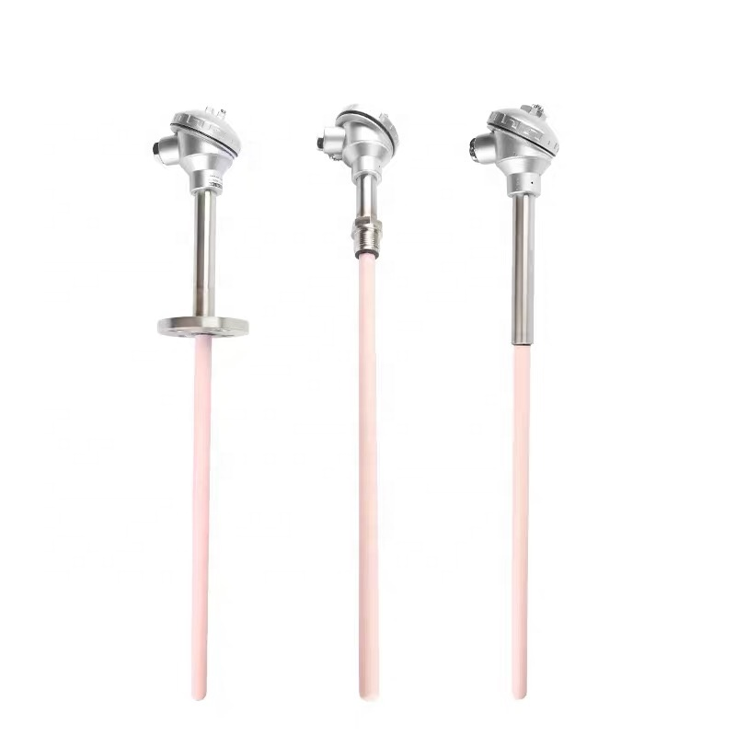
Thermocouple
https://www.alibaba.com/product-detail/S-type-platinum-rhodium-thermocouple-WRP_62093460341.html

Slide 27
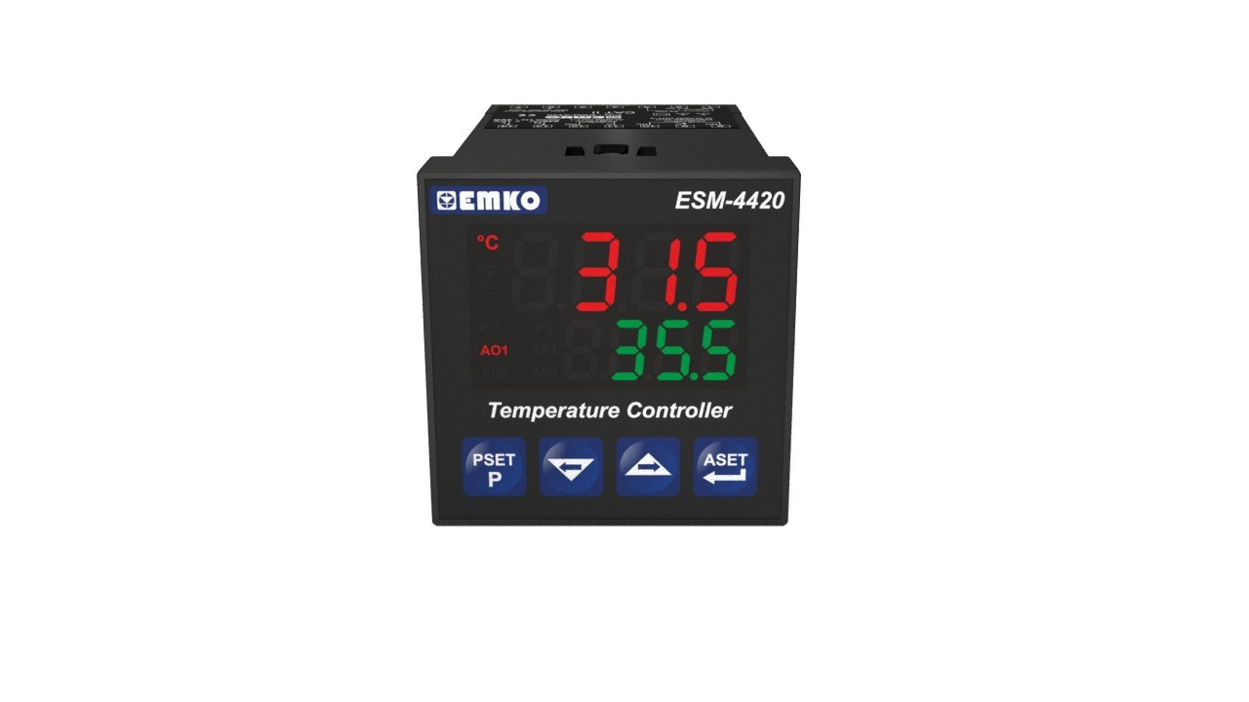
Control System
https://www.emkoelektronik.com.tr/tr/urunler/esm-4420

Slide 28
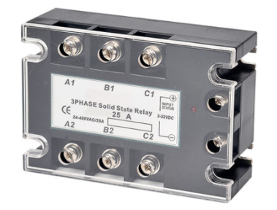
Relay
https://www.lazimbana.com/ssr-trifaze-solid-state-role-25a-40a-50a-75a-p-2823324

Slide 29
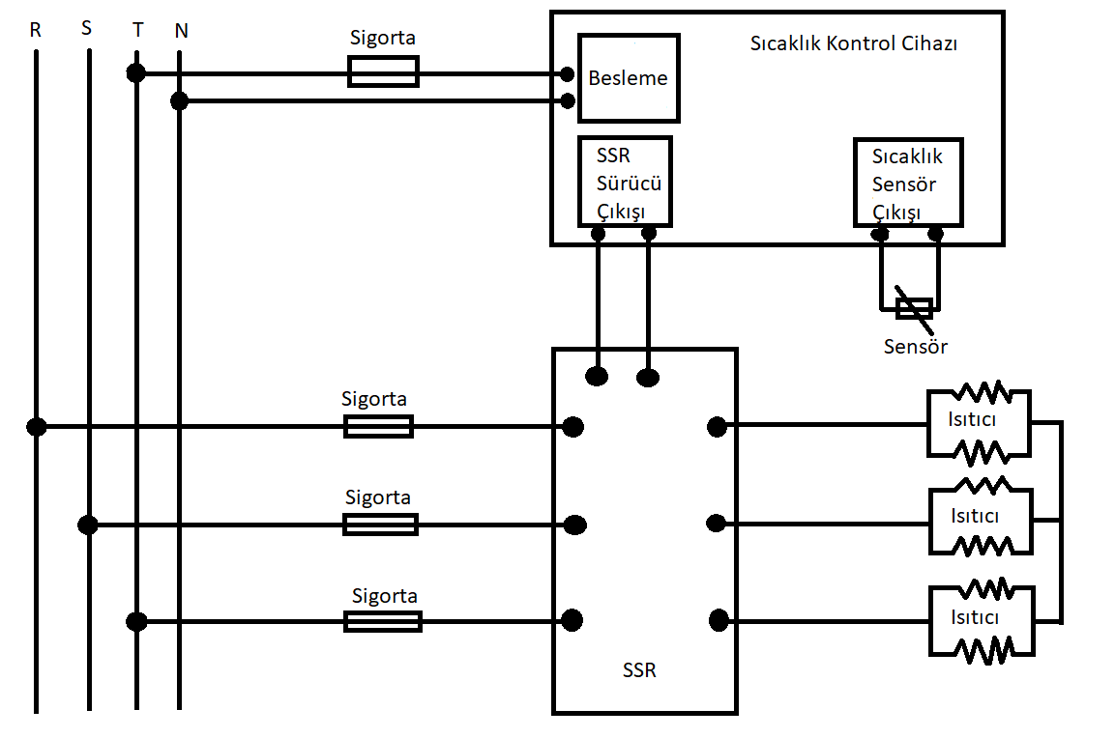
Circuit Diagram

Slide 30
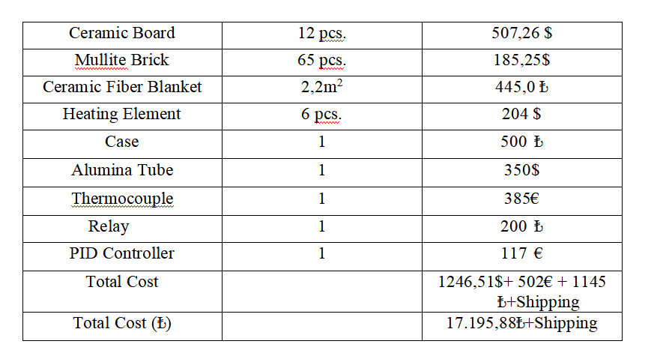
Cost

Slide 31
Conclusion
In conclusion, both box furnace and tube furnace have different abilities and usage areas. In this study, both box furnace and tube furnace investigated seperately and instead of using both furnaces seperately for different purposes, combination of the box and tube furnaces into one compact furnace can provide all the features of the box and tube furnace. Also at the end of the study, because of the compact furnace can be used as both tube and box furnace, there is no need to buy both box furnace and tube furnace seperately. That means cost and occupied area for the furnaces can be saved.

